Slide 1
Debrief 22/03/23

Slide 2
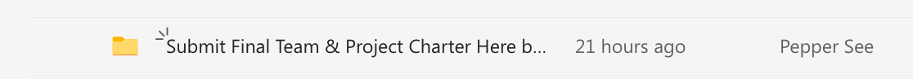
Programme for 23rd March 2023 (Thursday)
Time | Event | Venue
9.50am | Report to Republic Poly | E1 6T
10am | Corporate Project Preparation | E1 6T
12.30pm – 1.40pm | Lunch
1.40pm – 4pm | Strengths Finder Session 1 | Library
4.15pm – 4.30pm | Debrief & Week 2 Survey | E16T
Submission: | *Submission of Project Charter
Wear: Smart Casual
Things to Bring: Laptop with Charger, money for lunch, writing materials and handphone

Slide 3
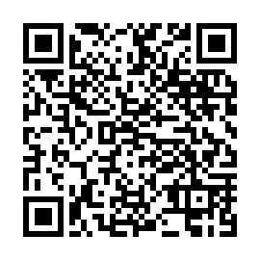
E-Learning Course Submission
https://tomowork.typeform.com/to/WPk6cy1j

